Slide 1
Modular network and informax principle in brain
June 20
Tianqin Li

Slide 2
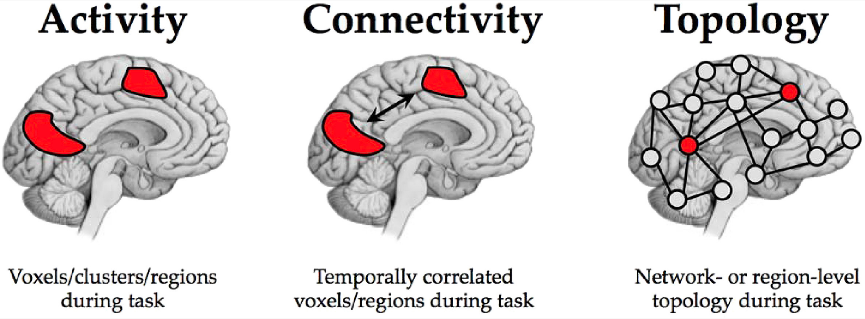
Using fMRI to measure fuctional connectivity
Form connection between temporal correlated regions
Constrained by structural connectivity but not necessary equal structural connection
Shine, J. M., & Poldrack, R. A. (2018). Principles of dynamic network reconfiguration across diverse brain states. NeuroImage, 180, 396-405.

Slide 3
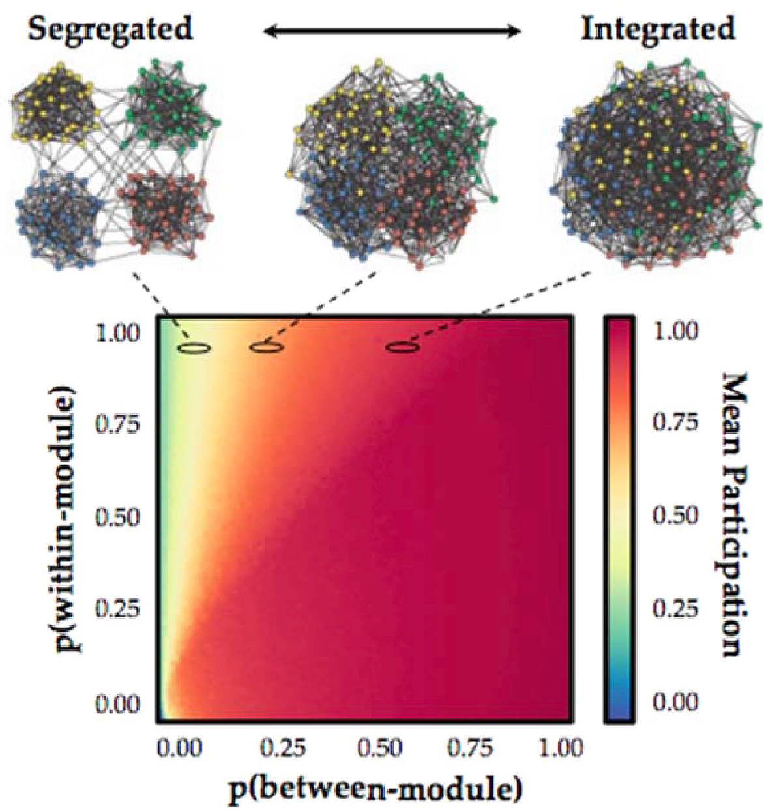
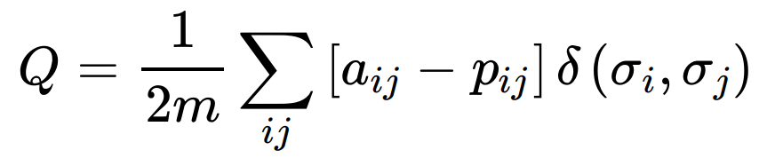
Segregated v.s. Integrated
Segregation (modular) :
Weak between modules
Strong within group
Integrated:
No clear distinction
Measurement of modularity:
Find partition for Modular Maximization
aij is the real weight between node i and j; pij is the expected random connection weight; last term is 1 only i,j are in the same module, 0 otherwise.
Shine, J. M., & Poldrack, R. A. (2018). Principles of dynamic network reconfiguration across diverse brain states. NeuroImage, 180, 396-405.
Notes:
It is hypothesized that simple, highly automated sensorimotor tasks can be maintained by a highly segregated brain organization, while more complex and cognitively demanding tasks require integration between multiple subnetworks

Slide 4
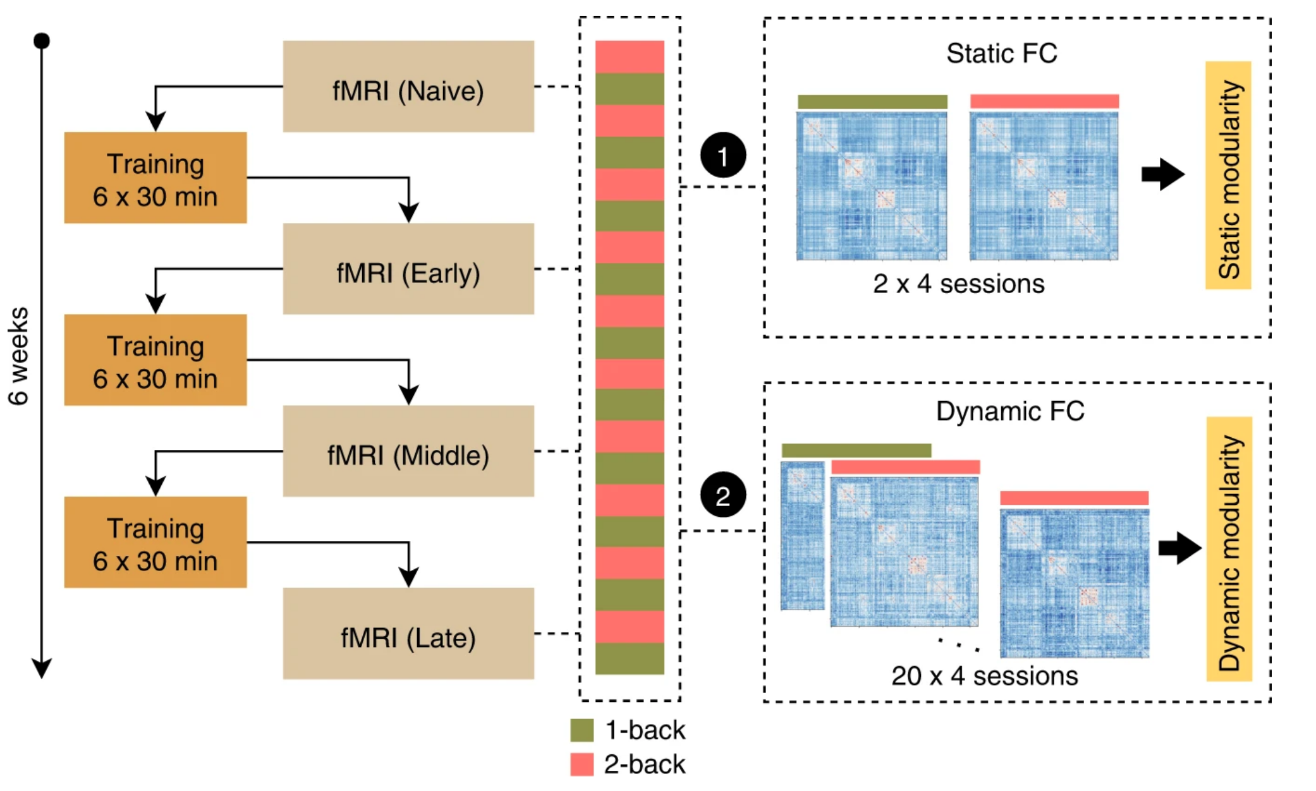
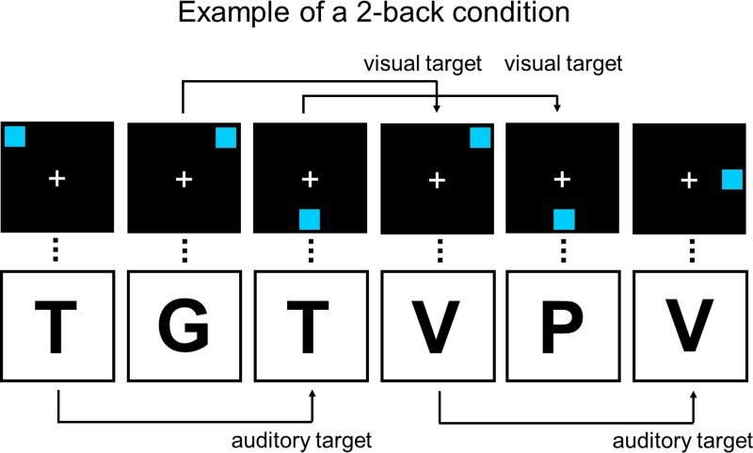
Modularity changes during training
Hypothesis:
A cognitive demanding task requires increase of integration
Training with cognitive demanding task results in more modular network
Experiments: Control and Experiment: 1&2-back in the scanner
Finc, K., Bonna, K., He, X., Lydon-Staley, D. M., Kühn, S., Duch, W., & Bassett, D. S. (2020). Dynamic reconfiguration of functional brain networks during working memory training. Nature communications, 11(1), 1-15.

Slide 5
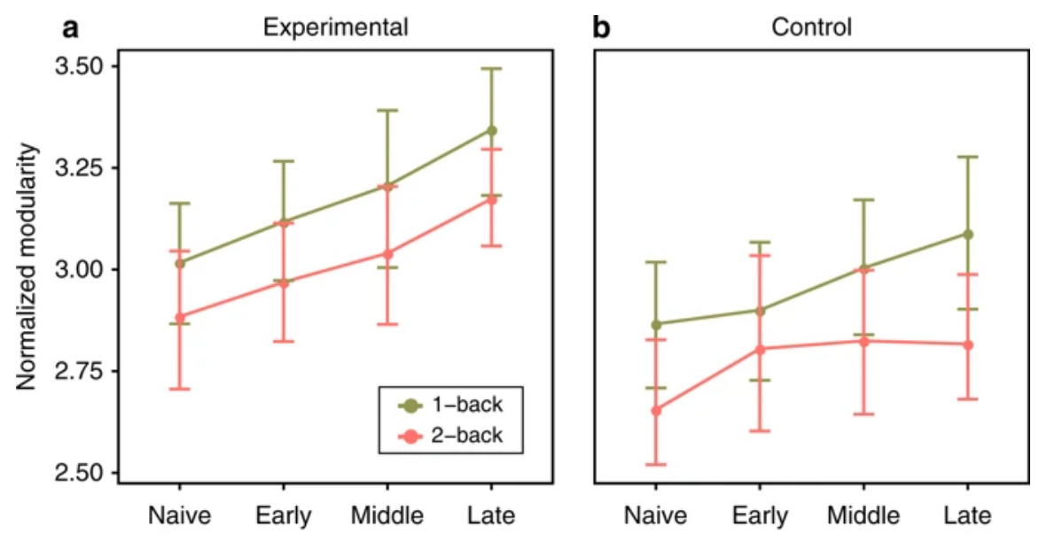
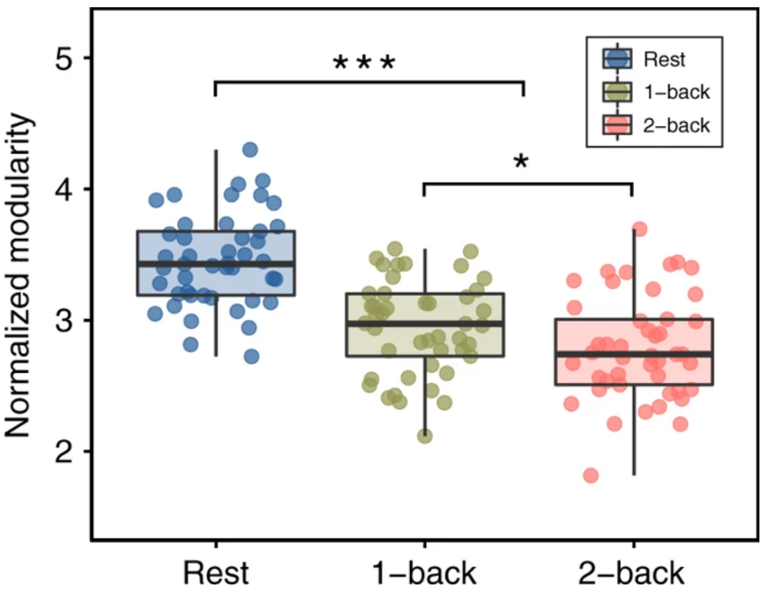
Brain modularity level changes
During training, modularity decrease as the task become more cognitive demanding
After training, whole brain level modularity increase
Finc, K., Bonna, K., He, X., Lydon-Staley, D. M., Kühn, S., Duch, W., & Bassett, D. S. (2020). Dynamic reconfiguration of functional brain networks during working memory training. Nature communications, 11(1), 1-15.

Slide 6
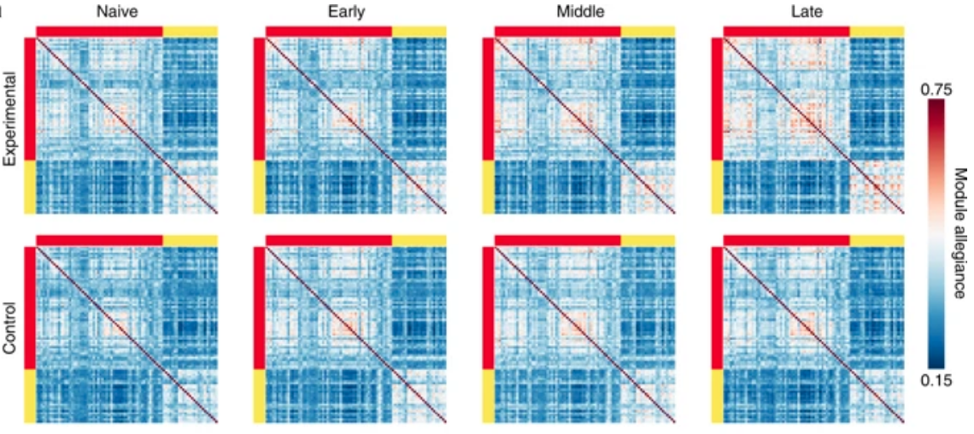
Dynamic reorganization of modular network
Calculate Allegiance matrix P:
Pij is the proportion of blocks during testing that node i and node j is in the same module
Training increase the allegiance in the network
Finc, K., Bonna, K., He, X., Lydon-Staley, D. M., Kühn, S., Duch, W., & Bassett, D. S. (2020). Dynamic reconfiguration of functional brain networks during working memory training. Nature communications, 11(1), 1-15.

Slide 7
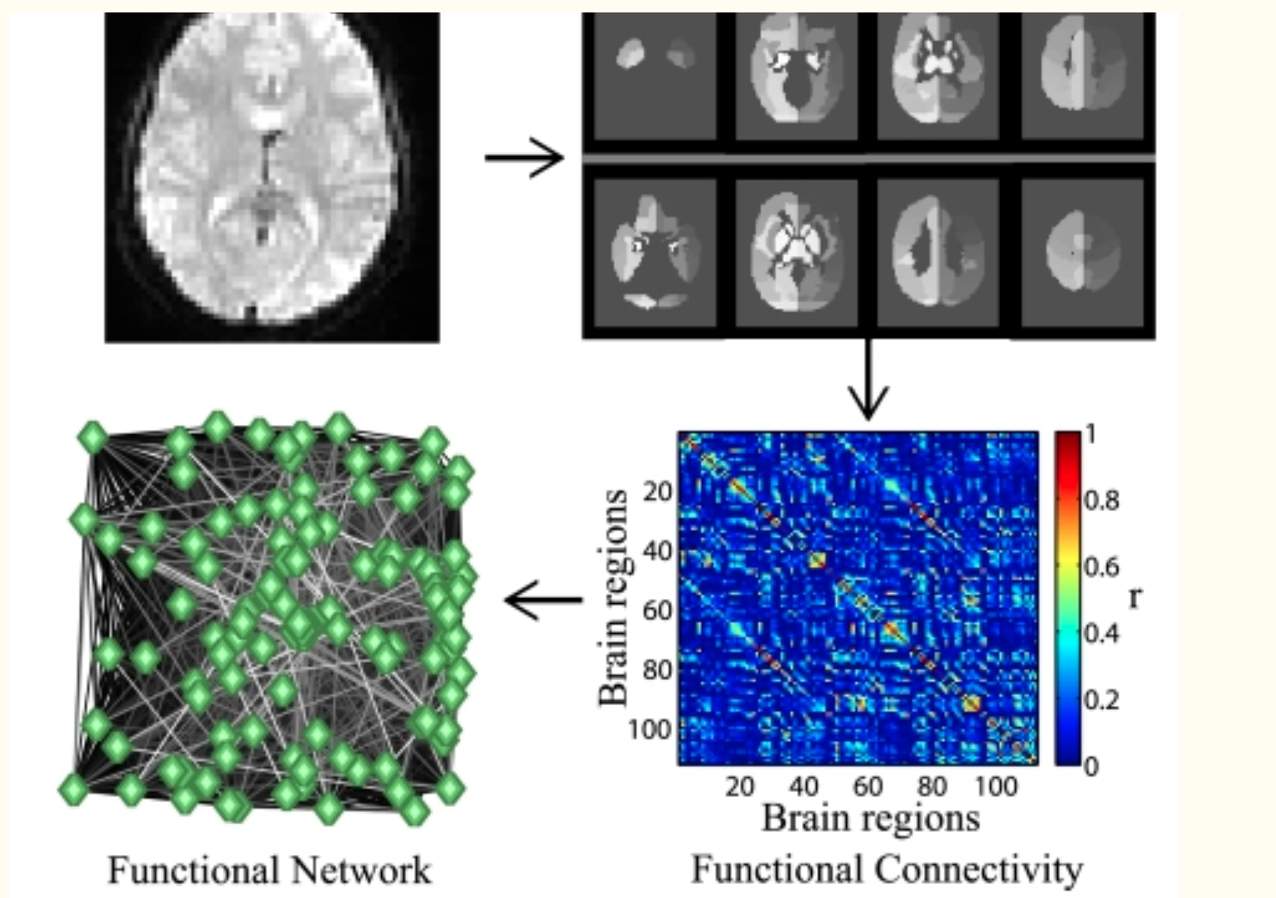
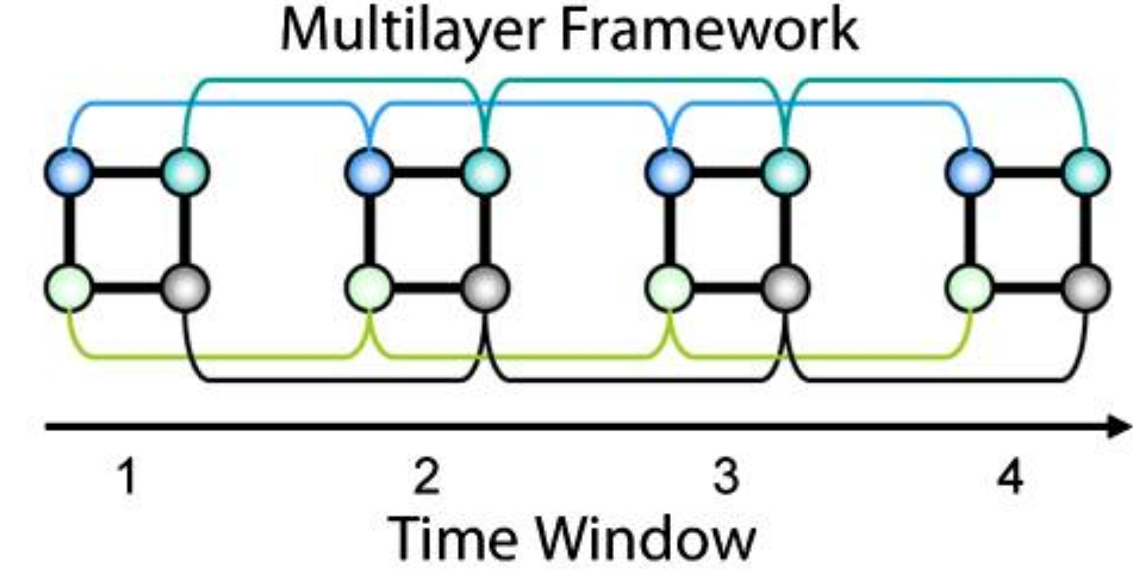
Dynamic reconfiguration of human brain networks during learning
Another work also showing the dynamics reconfiguration
Bassett, D. S., Wymbs, N. F., Porter, M. A., Mucha, P. J., Carlson, J. M., & Grafton, S. T. (2011). Dynamic reconfiguration of human brain networks during learning. Proceedings of the National Academy of Sciences, 108(18), 7641-7646.

Slide 8
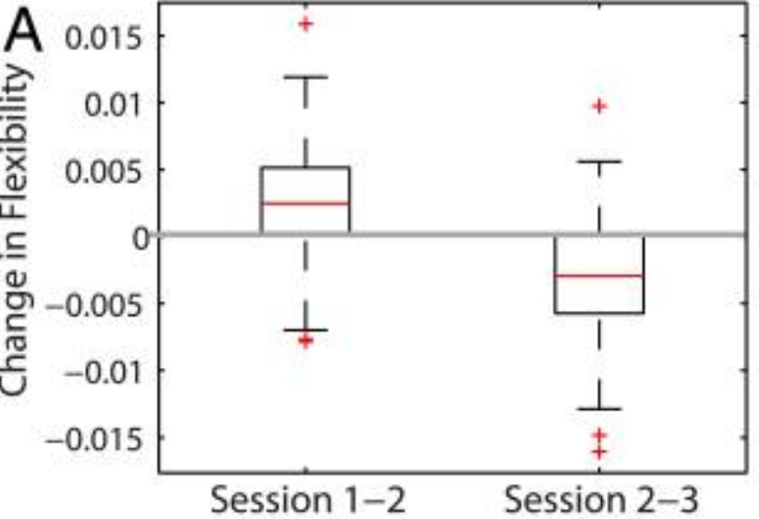
Flexibility of the network changes during training
Flexibility:
“Flexibility” is the number of times that each node changes module allegiance
Temporal module is calculated by Louvain greedy algorithm (next slides)
The flexibility of the network as a whole is then defined as the mean flexibility over all nodes
Flexibility changes over the learning:
Increase first
Then decrease
Bassett, D. S., Wymbs, N. F., Porter, M. A., Mucha, P. J., Carlson, J. M., & Grafton, S. T. (2011). Dynamic reconfiguration of human brain networks during learning. Proceedings of the National Academy of Sciences, 108(18), 7641-7646.

Slide 9
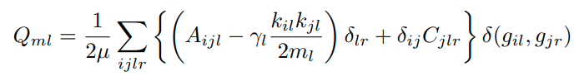
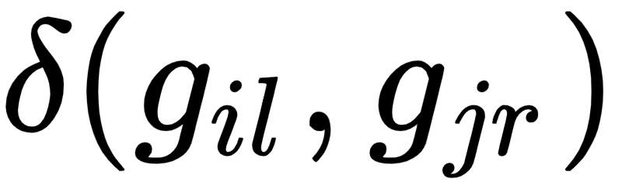
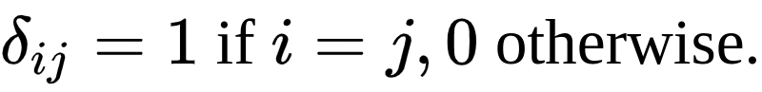
Louvain greedy algorithm
Modular across different temporal layers are recalculated by the following:
Jointly maximize the a module assignment function for assigning gil:
If node i in layer l is in the same module of node j in layer r, the is 1.
Different from
The details are in the supplementary under the section “Multilayer Network Modularity: Temporal Dynamics of Intra-Session Connectivity” (page 12) (https://www.pnas.org/content/pnas/suppl/2011/04/18/1018985108.DCSupplemental/Appendix.pdf)
the first proposal of Louvain greedy algorithm can be found in
Mucha, P. J., Richardson, T., Macon, K., Porter, M. A., & Onnela, J. P. (2010). Community structure in time-dependent, multiscale, and multiplex networks. science, 328(5980), 876-878.
Bassett, D. S., Wymbs, N. F., Porter, M. A., Mucha, P. J., Carlson, J. M., & Grafton, S. T. (2011). Dynamic reconfiguration of human brain networks during learning. Proceedings of the National Academy of Sciences, 108(18), 7641-7646.

Slide 10
Summarize
Cognitive effortful task require modules integrated together
Training increase the network modularity
Flexibility of the network increase and then decrease during training
What can we do with the modular network?
The brain’s modularity can be changed, not pre-defined, since the competition between modularity and integrative can balance our brain for new task learning (require integration of existed modules) and using existed learnt modules (automatically use the modules)
The module flexibility can be dynamic so that it would be easy to learn (learn faster once start learning) and resist to forget once the module formed.

Slide 11
Principles of Mutual Information Maximization and Energy Minimization Affect the Activation Patterns of Large Scale Networks in the Brain
Kosuke Takagi
Front. Comput. Neurosci., 09 January 2020 | https://doi.org/10.3389/fncom.2019.00086

Slide 12
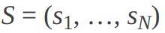
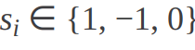

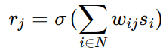

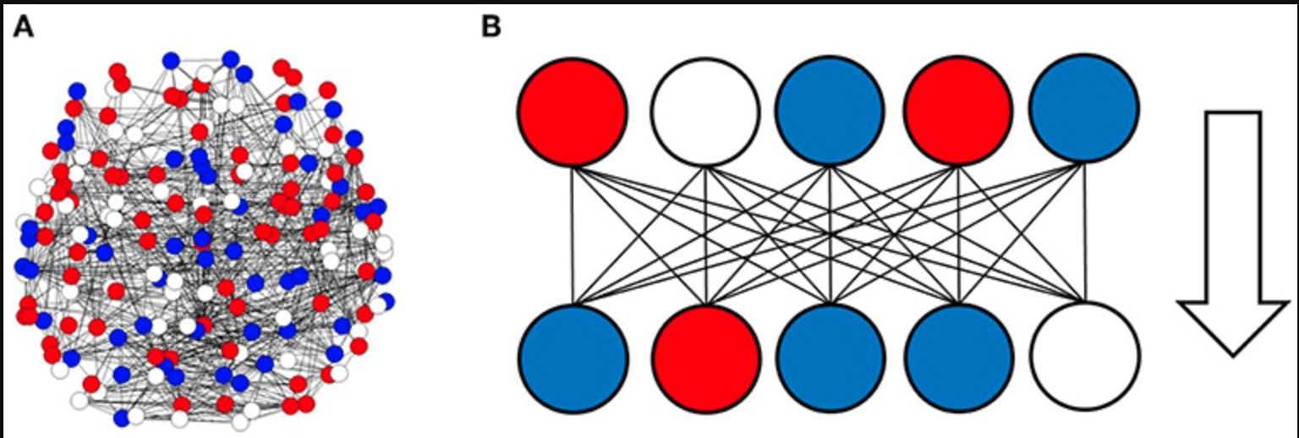
Basic setup
S
Given input state of the brain, based on A’s connection, calculate the response state of the brain.

Slide 13
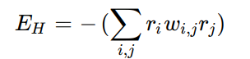
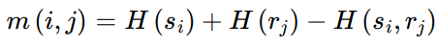
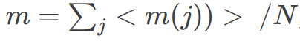

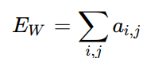
Basic setup
D
Weight are obtained by fMRI connectivity
Network energy: ri, rj are the response of each neuron, wij is the weight
Mutual information between input s and output r
Wiring cost:
aij = 1 if |wij| > threshold, 0 otherwise

Slide 14
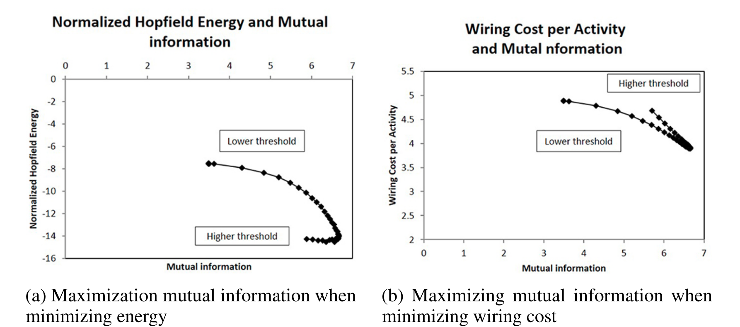
When maximizing mutual information
Mutual information, energy and wiring cost are all functions of threshold.
Energy and wiring cost is minimized when maximizing mutual information between input and response

Slide 15
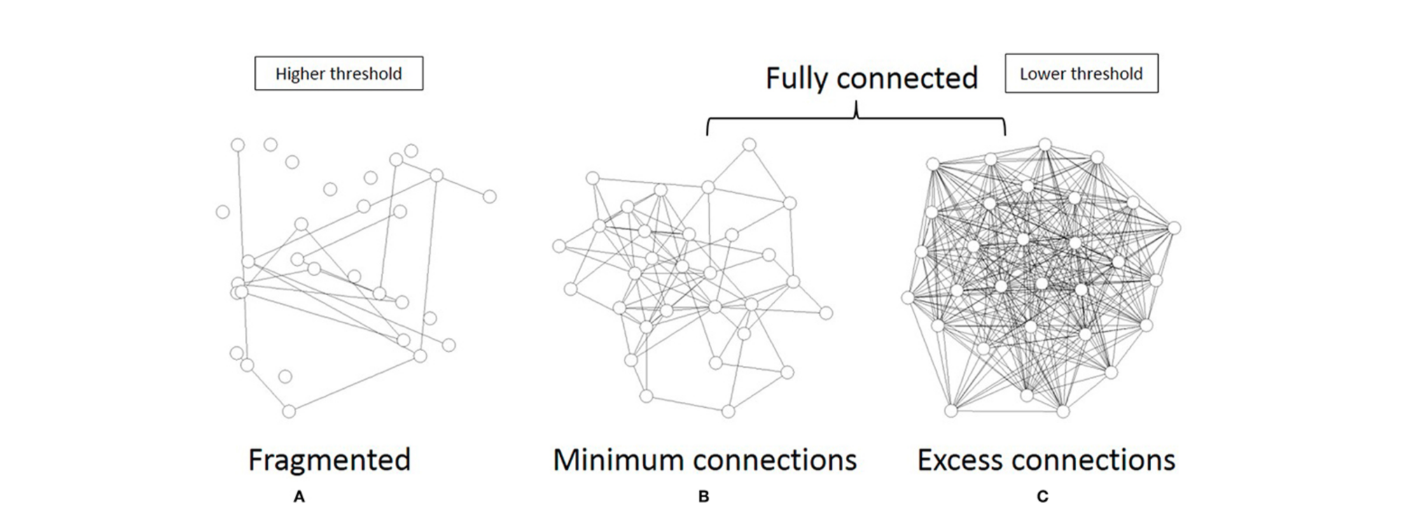
Small world principle of network topology
The middle connection threshold
maximizes the mutual information
minimizing energy and wiring cost.
It connects most of the neurons with minimum connections, following a small-world principle.

